Slide 1
The Epic Hero Traits
7 Characteristics

Slide 2
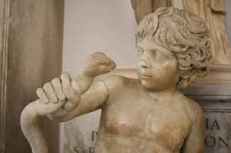
Trait #1 - A Noble Birth
Most epic heroes are demigods or come from royal blood. Many epic heroes have unusual births and their strengths are tested at an early age.
Heracles strangles a snake as a youth.

Slide 3
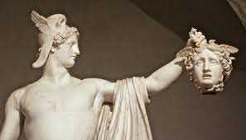
Trait #2 - Capable of deeds of great strength and courage
Epic heroes will demonstrate feats almost impossible for the average mortal. Unfortunately, epic heroes are not always performing good deeds.
Perseus holds the head of Medusa.

Slide 4
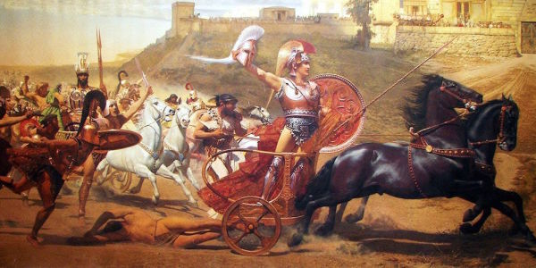
Trait #3 - Great Warrior
An epic hero builds a reputation established by great feats in battle and war. Epic heroes are known by their skills in warfare.
Trojan War battle scene

Slide 5
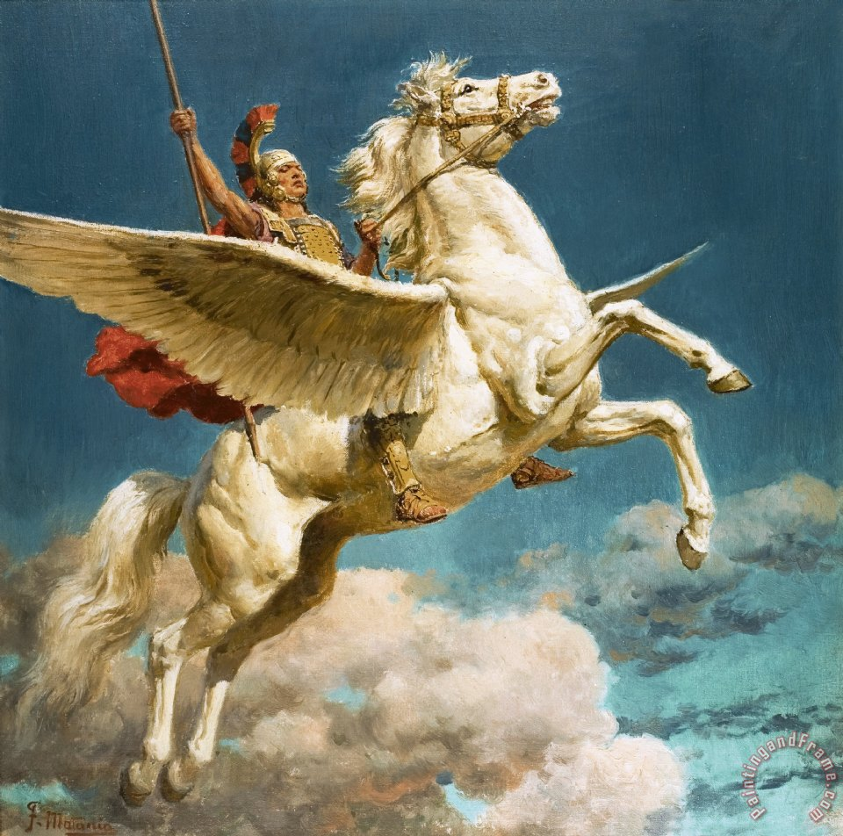
Trait #4 - Travels or quests are pursued
An epic hero will be forced to travel great distances and perform great tasks for mankind and not just protect the local village.
Bellerophon

Slide 6
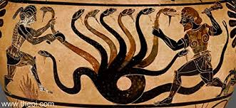
Trait #5 - National Heroism
An epic hero will be celebrated by those who sing of his exploits. His fame will recognized by many throughout the land.
Heracles faces the Hydra.

Slide 7
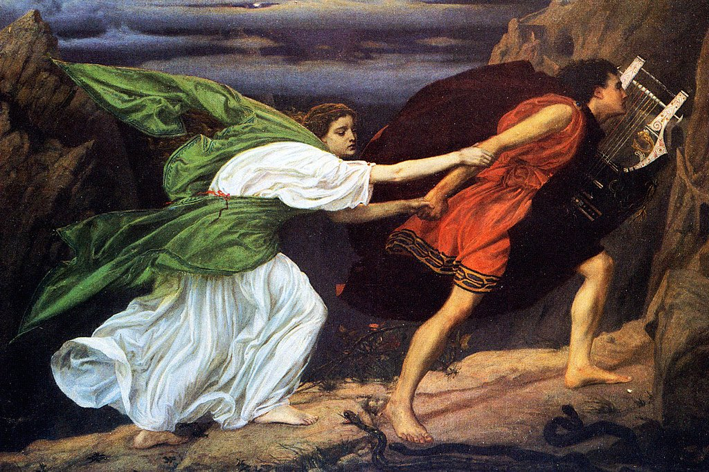
Trait #6 - Humility
Despite the fame and applause, epic heroes show humility. They are not braggarts. Great deeds are not done for the rewards.
Orpheus and Eurydice

Slide 8
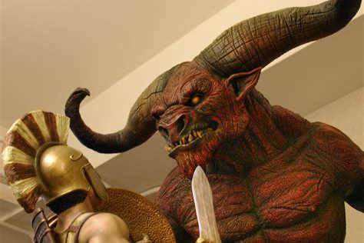
Trait #7 - Faces Supernatural Foes
Epic heroes faced many challenging foes but with the aid of gods and goddesses, they were able to conquer those monsters.
Theseus and the minotaur

